Slide 1
Towards benchmarking spatially resolved cell-cell communication methods
Ian Dirk Fichter
Supervisor: Elyas Heidari

Slide 2
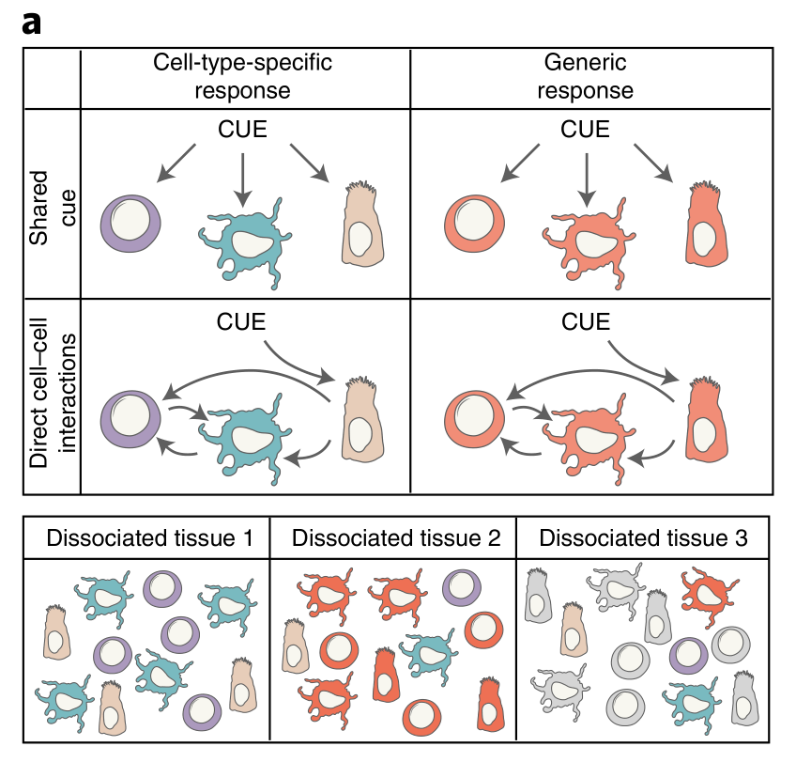
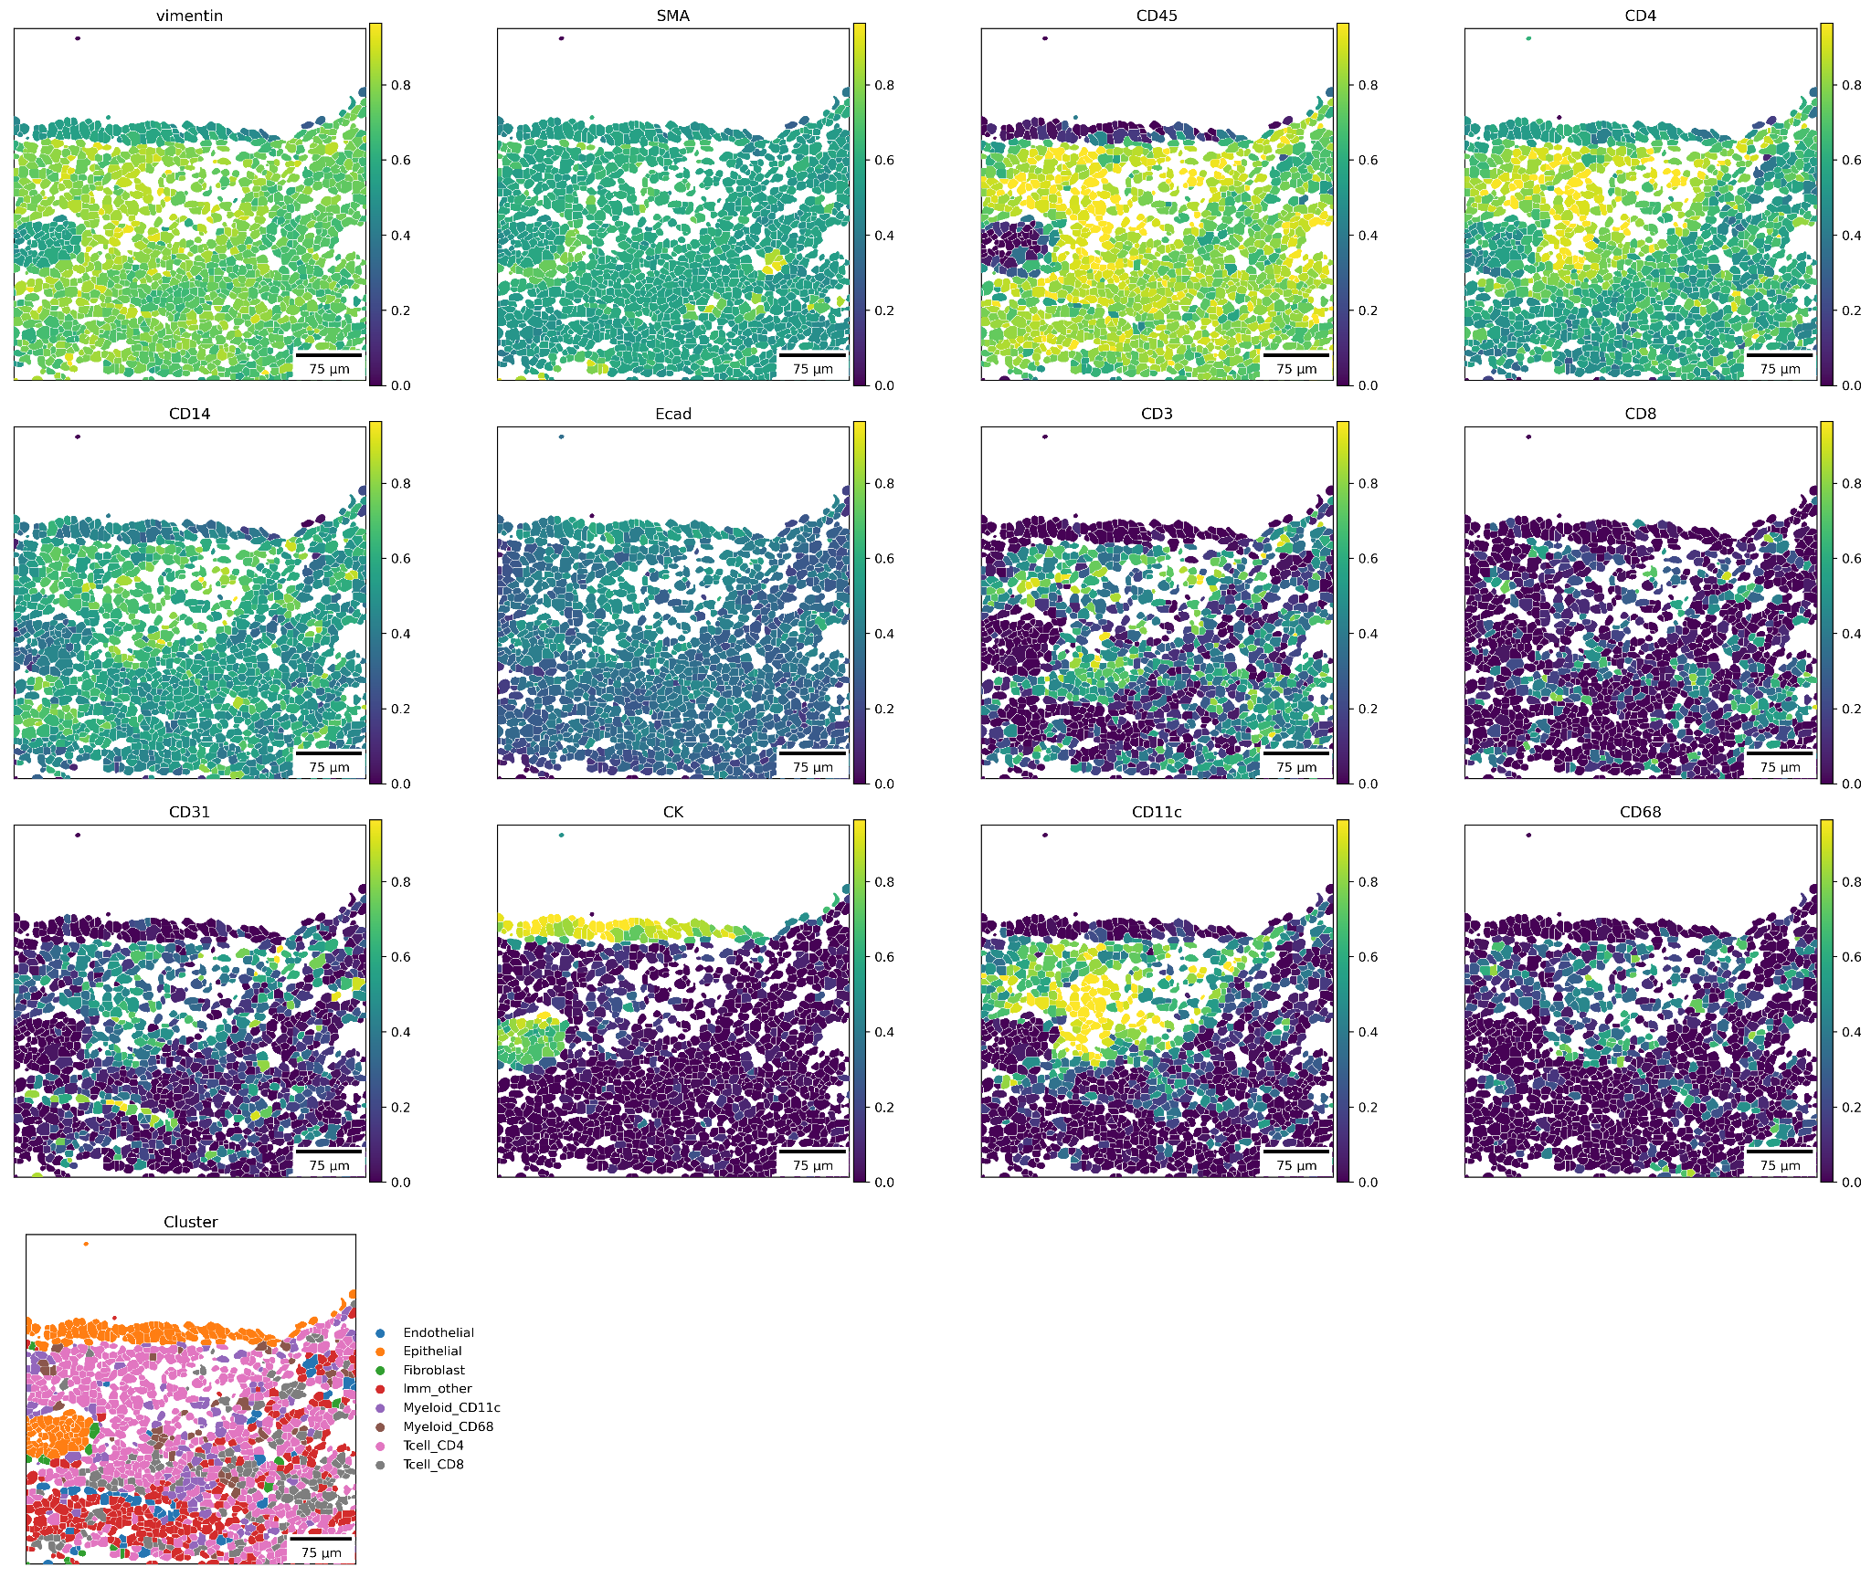
What is cell-cell communication?
Jerby-Arnon, L, and Regev, A (2022). DIALOGUE maps multicellular programs in tissue from single-cell or spatial transcriptomics data. Nat Biotechnol 40, 1467–1477.
Notes:
Cell cell communication, although hard to define, the community has converged to the definition of effects that arise and are only explainable via the local spatial structure of the cells and cannot be recovered from individual cell expression profiles.
E.g. Hartmann2021: interaction of epithelial (cancer) cells with the adjacent immune cells. Hartmann found CD8+T cells to be expressing activation and exhaustion markers near the tumour-immune border. (C)yto(K)eratin is a marker for epithelial cells (~cancer in this case), CD11c for leukocytes, CD45 differentiated haematopoietic cells
.

Slide 3
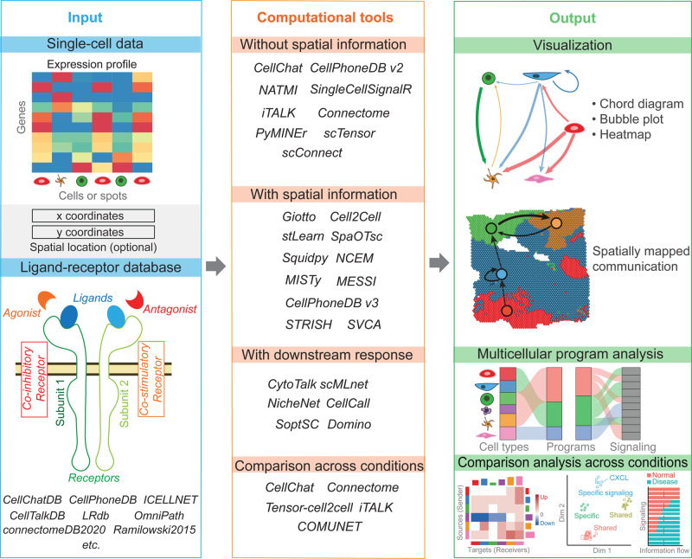
Cell-cell communication field is still in its infancy
No clear gold-standard
Technologies vastly differ in capture types
No established approach to cell-cell communication
Jin, S, and Ramos, R (2022). Computational exploration of cellular communication in skin from emerging single-cell and spatial transcriptomic data. Biochem Soc Trans 50, 297–308.
Notes:
There is no consensus on any preprocessing steps, common analysis or superior methods.
Many technologies don’t present L-R features
No established CCC approach.
Input: many technologies, vary vastly. Big problem to adapt them to every method
CCC tools are categorized mainly into Spatial/Non-spatial and using or not using prior-knowledge
Many visualization methods

Slide 4
Fundamental challenge
Upstream conditions:
Preprocessing
Signal decoding
Segmentation
Cell-type annotation
QC
Tissue type and condition generalizability
Technology
Resolution
FOV
Inter-spot space
Sensitivity
Notes:
As is
Example image. Neighbouring cells segmentation could go wrong and attribute both ligand and receptor to the same cell
CCC behaves differently depending on tissue and condition. I learned this must be taken into account while applying CCC methods because it can vastly influence your results depending on which conditions were included. Should one integrate?
Different technologies make too many input types that are all processed differently

Slide 5
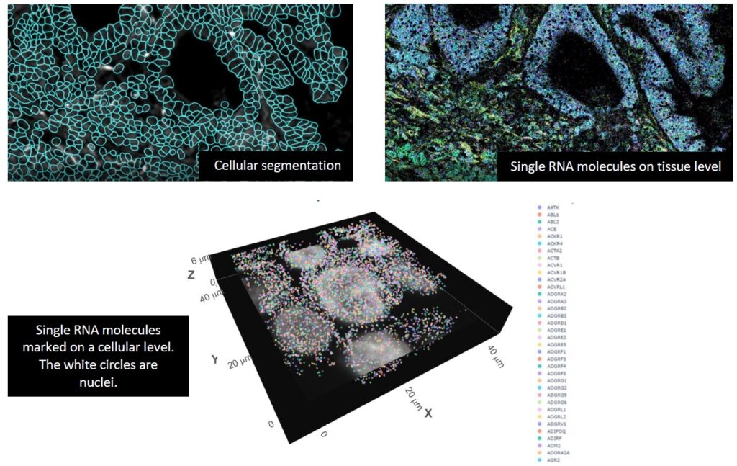
Cell segmentation example
Tissue depth
Segmentation method
Cell size normalization
https://useq.nl/spatial-omics/
Notes:
Example image. Neighbouring cells segmentation could go wrong and attribute both ligand and receptor to the same cell due to wrong border placement
RNA molecules can also belong to underlying or overlying cells in 3D space but be wrongfully attributed to a different cell
As is

Slide 6
GOAL: Benchmarking
Assessment of the effect of the imperfect upstream steps
Method applicability comparison
Workflow standardization
! Challenge: Lack of ground-truth !

Slide 7
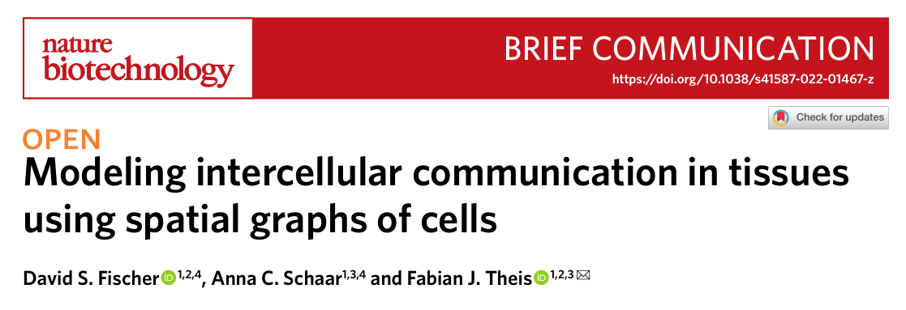
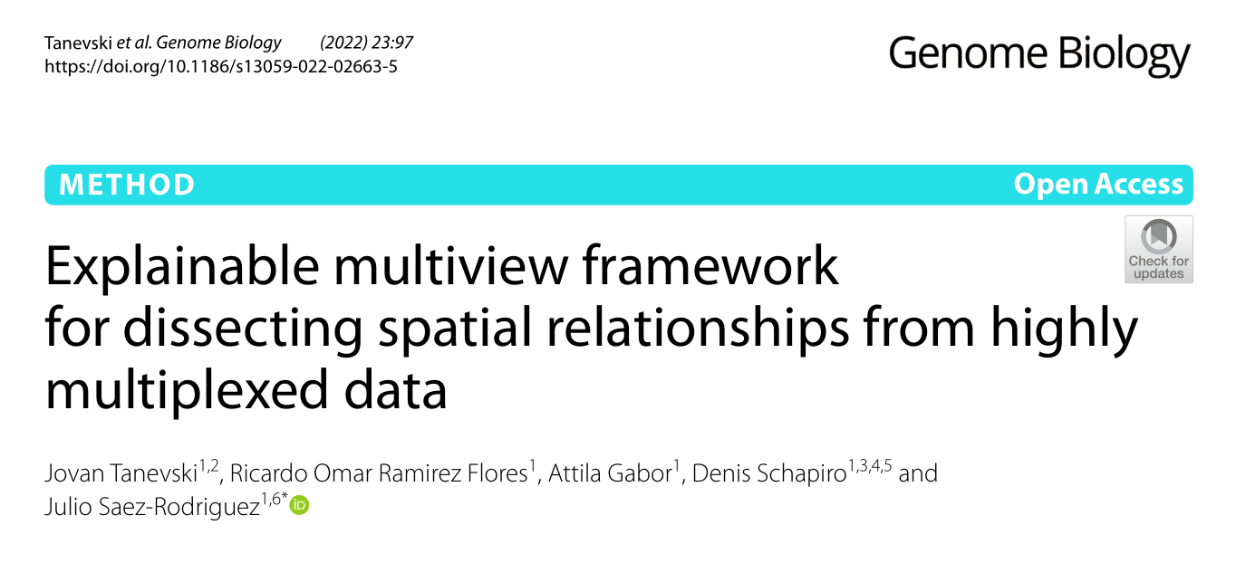
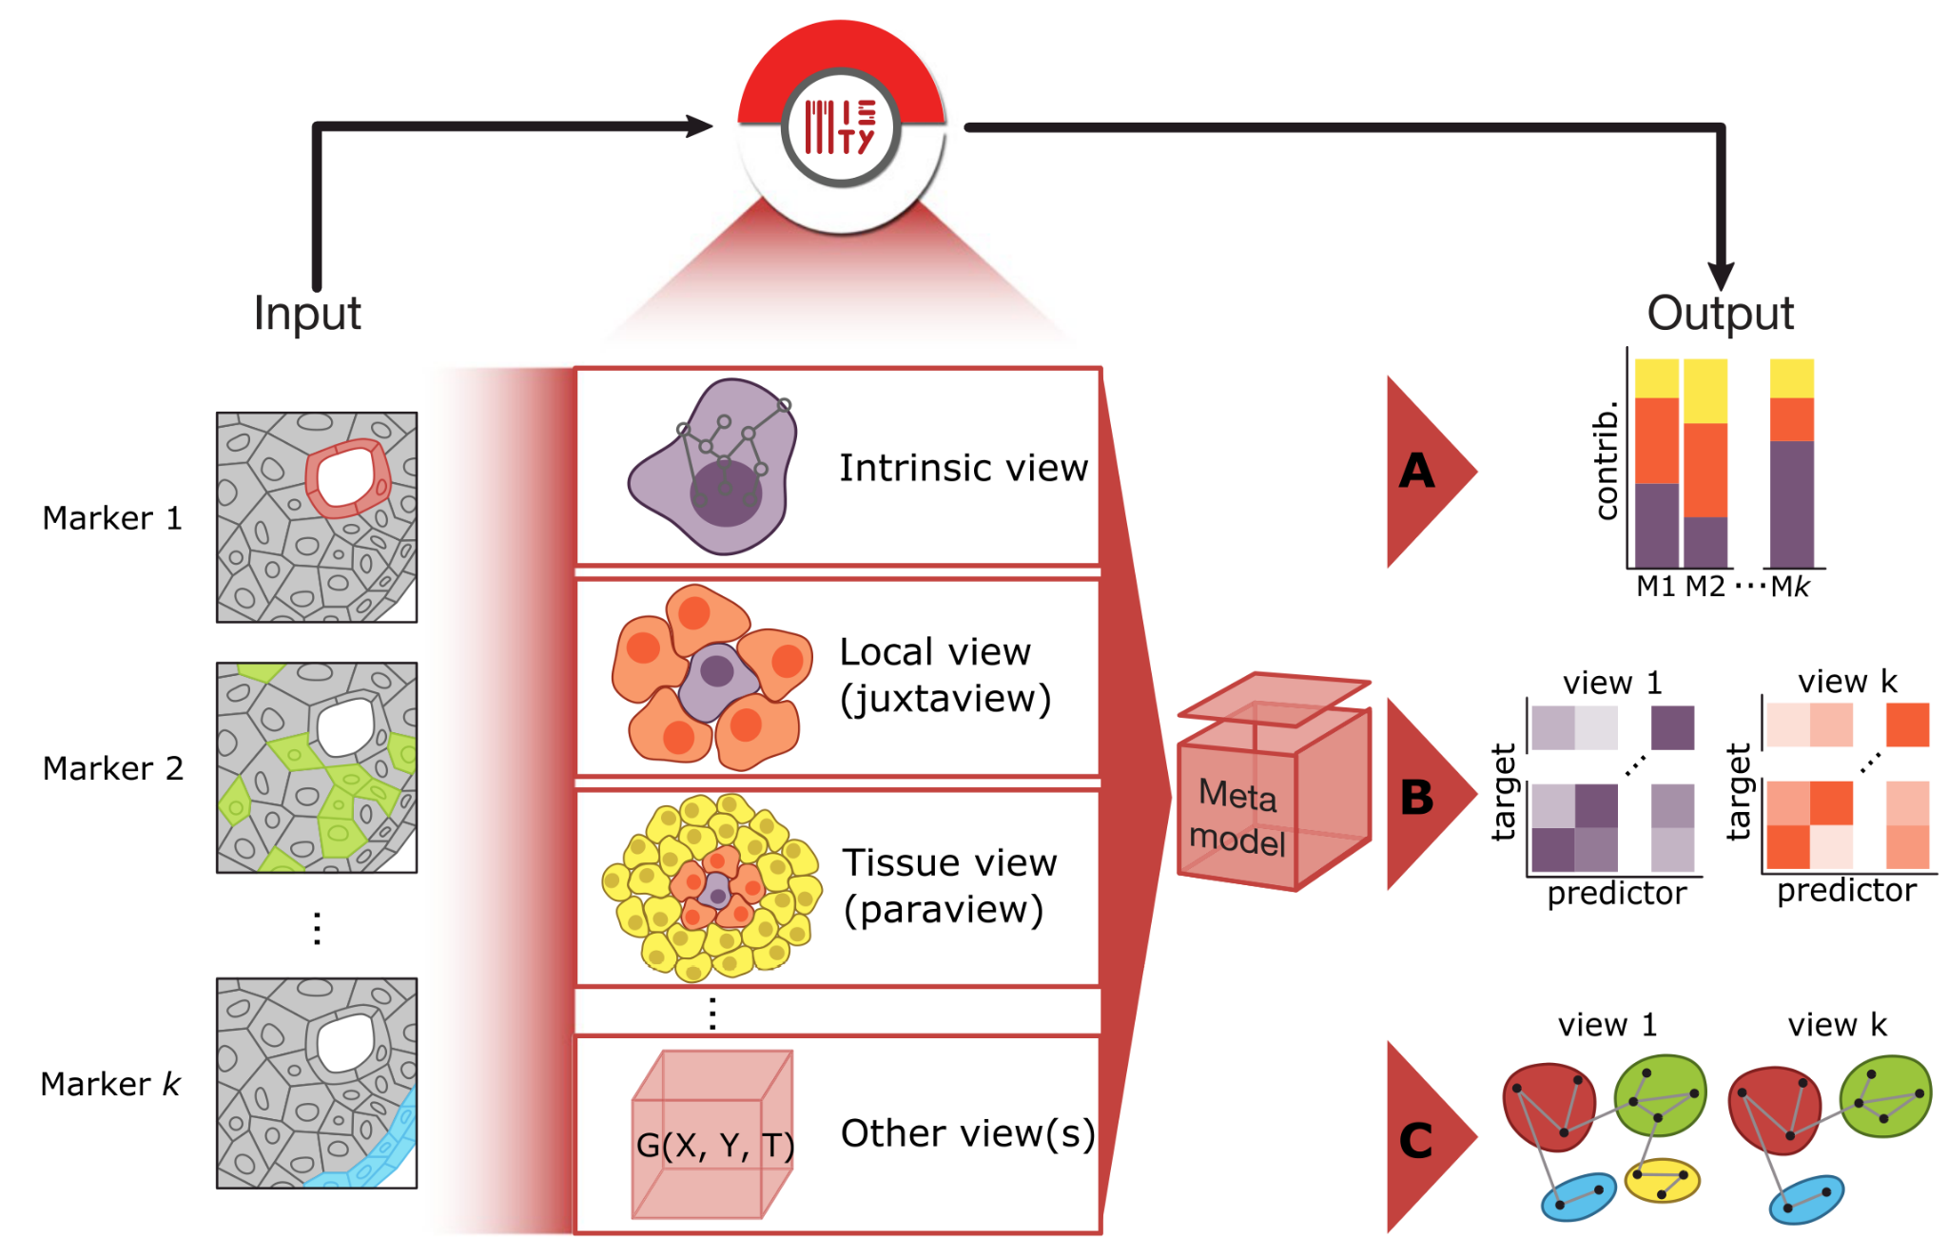
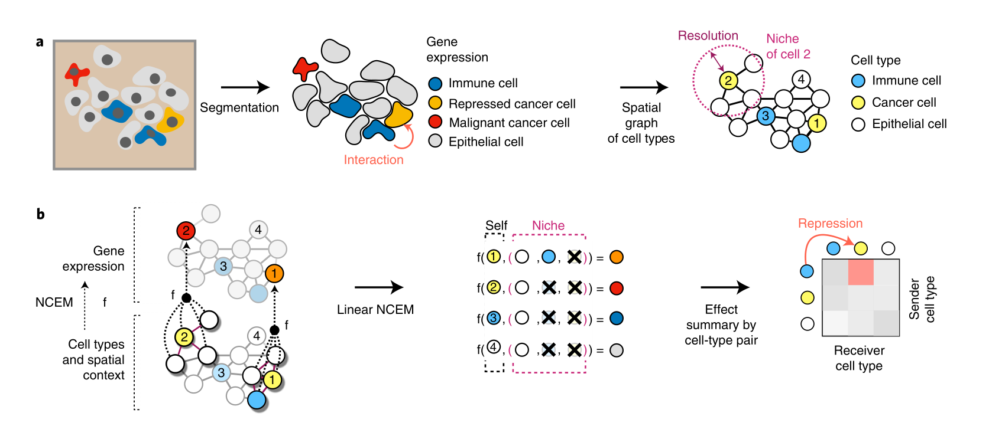
Notes:
Decided to apply some CCC methods and assess IO as well as benchmark
NCEM are popular in Spatial club Heidelberg and Spatial Biohackathon in December
ML-based methods which model spatial neighbourhood (niche) effects
Recover molecular signatures of processes underlying cell-cell communication

Slide 8
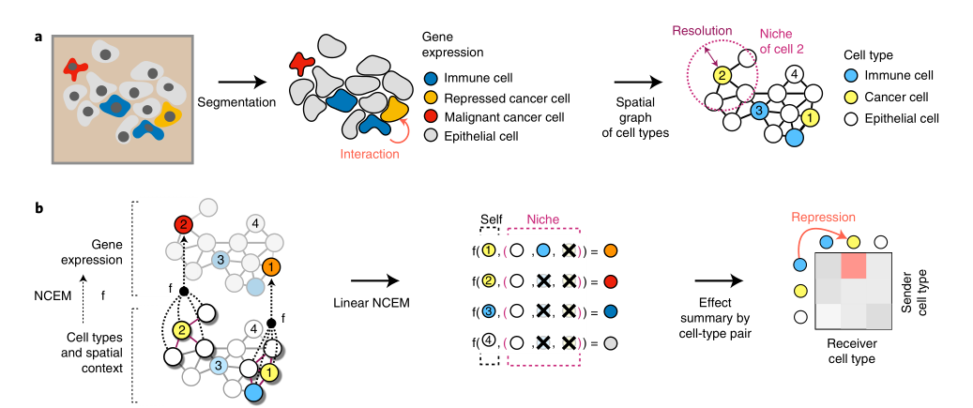
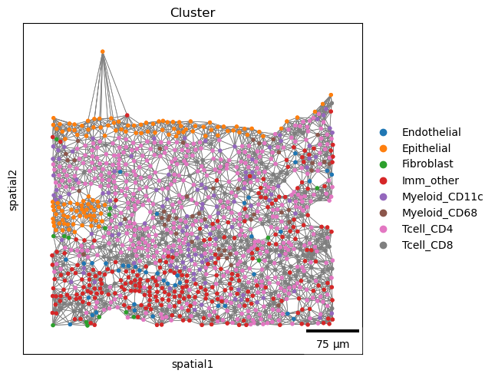
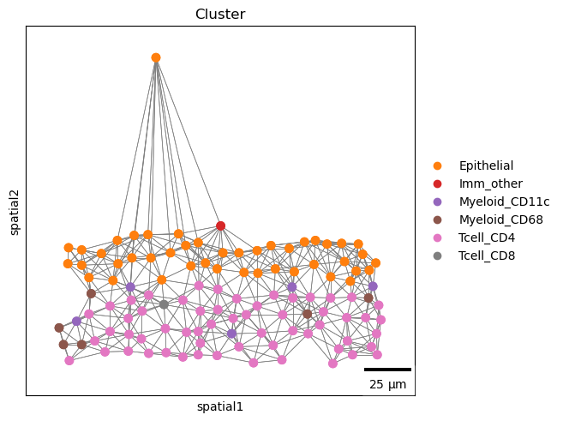
NCEM - linear model
Fischer et a. 2022
Notes:
Node centric expression model
Graph based
Input: cell-type labels
Output: gene expression → summarized per cell-type
Predicts index cell gene expression based on own label and neighbourhood cell-type indicator function

Slide 9
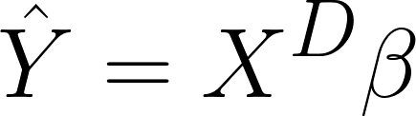
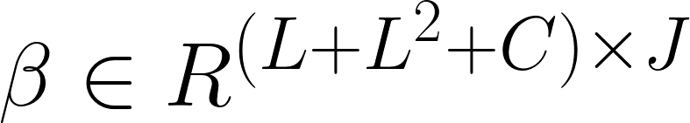
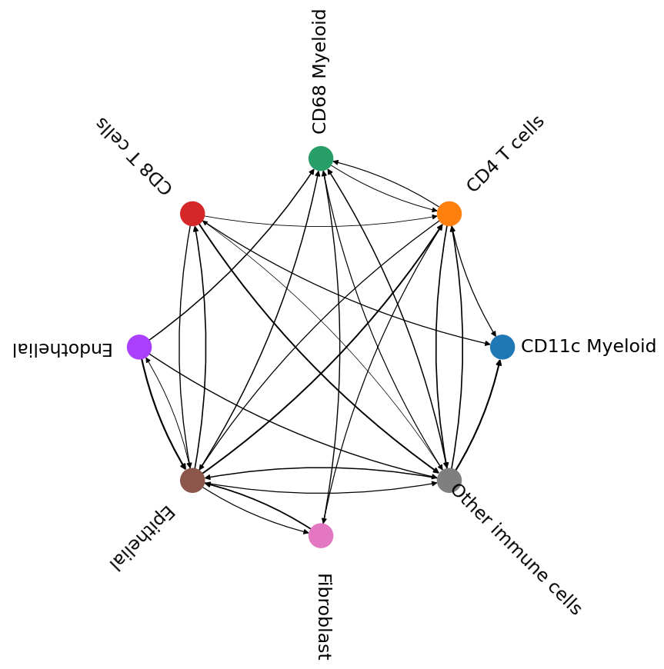
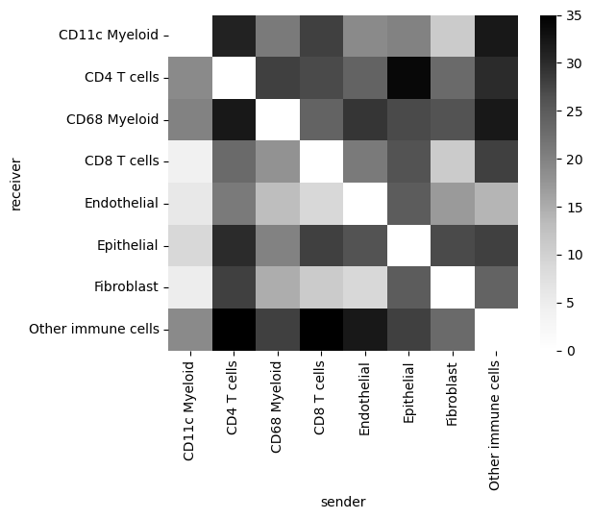
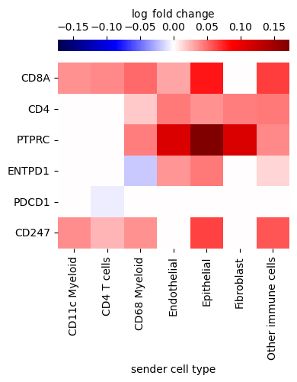
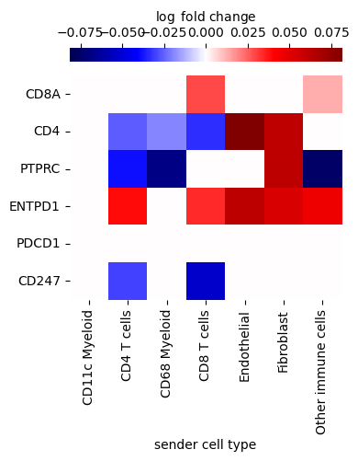
Linear model
Predicts gene expression based on index cell type and niche composition
condition (1hot)
gene expression
cell type (1hot)
Interaction terms (ct^2)
gene expression
cell type
+
interaction terms
+
batch
cell ids
= nodes
=
Notes:
Here’s the design
IO

Slide 10
Linear model: Fischer’s findings
- Infer and recover cell-cell communication signatures, biological validation*
- Outperformed nonspatial baseline models consistently by an average ΔR2 of 0.016
- Recover L-R interactions from CellPhoneDB and NicheNet
- Robust to:
- data downsampling
- out-of-domain data from an unseen genetic knockout condition
- to simulated segmentation errors (feature vector shuffling between neighbours)
- removal of the interaction terms from the linear model

Slide 11
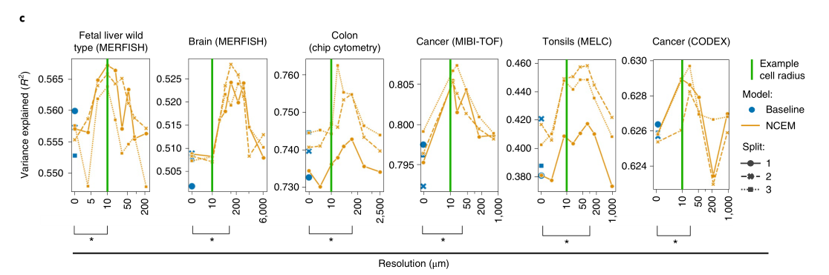
Technology and tissue variability
Notes:
Hypothesized NCEM downside: reliance on cell-type annotation and segmentation. This is very imprecise in spatial omics. It happened that >10% of cells are wrongly labelled or transcripts attributed to the wrong cell.
Fischer already showed NCEM (and optimal radius) varies strongly between technologies and also tissue types
R2 as the performance validation measure by radius
How much of the spatial variance is the model capable of capturing?
Compared to baseline (no spatial information) it almost always outperforms

Slide 12
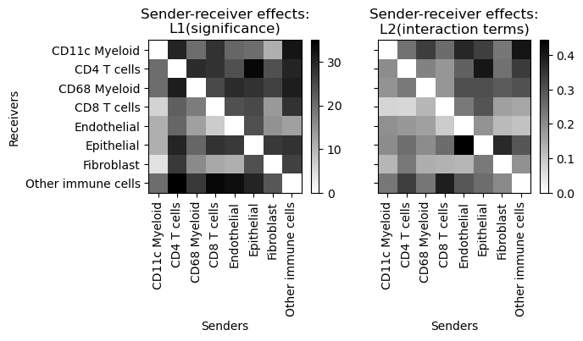

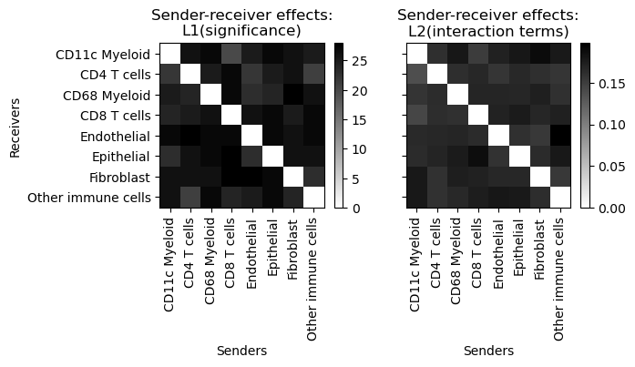
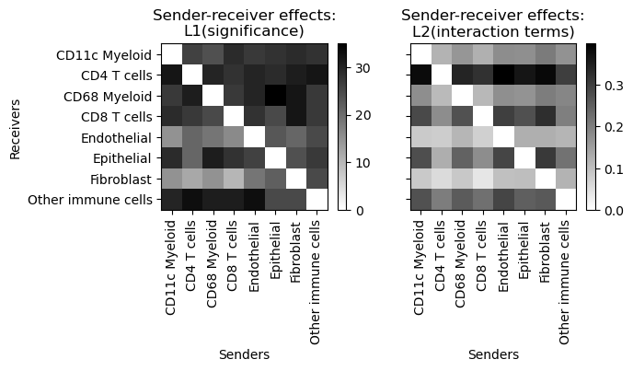
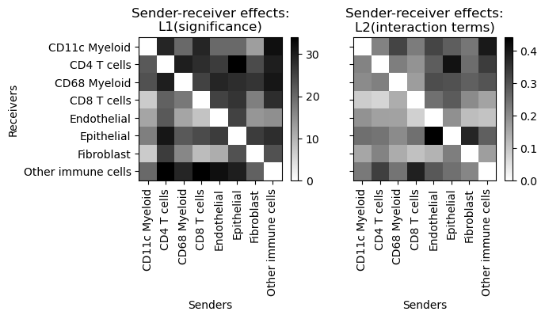
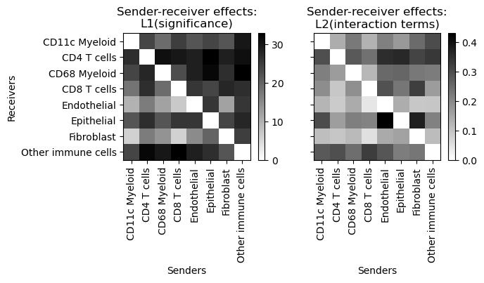
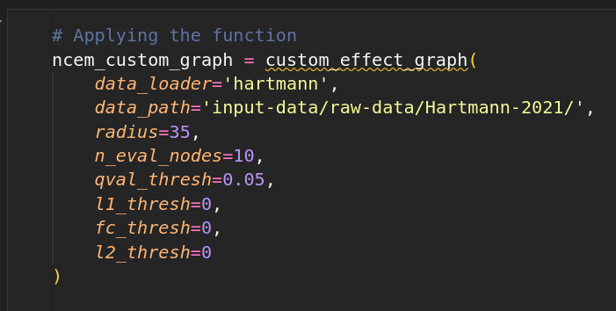
Wrapper output: interaction terms
Not shuffled
0.1% shuffled
10% shuffled
100% shuffled
1% shuffled
50% shuffled
Notes:
I wrote a wrapper to make NCEM more intuitive and useful
Elyas and I hypothesized that NCEM strongly relies on cell-types and therefore shuffling the cell-type on increasing fractions of cells will make the predicted interactions less specific and more uniform

Slide 13
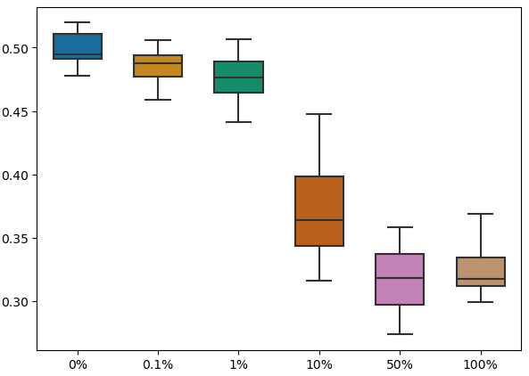
Shuffling cell-types shows sensitivity to annotation
R^2
Fraction of cells shuffled
Notes:
Here a visual representation of the shuffling effects

Slide 14
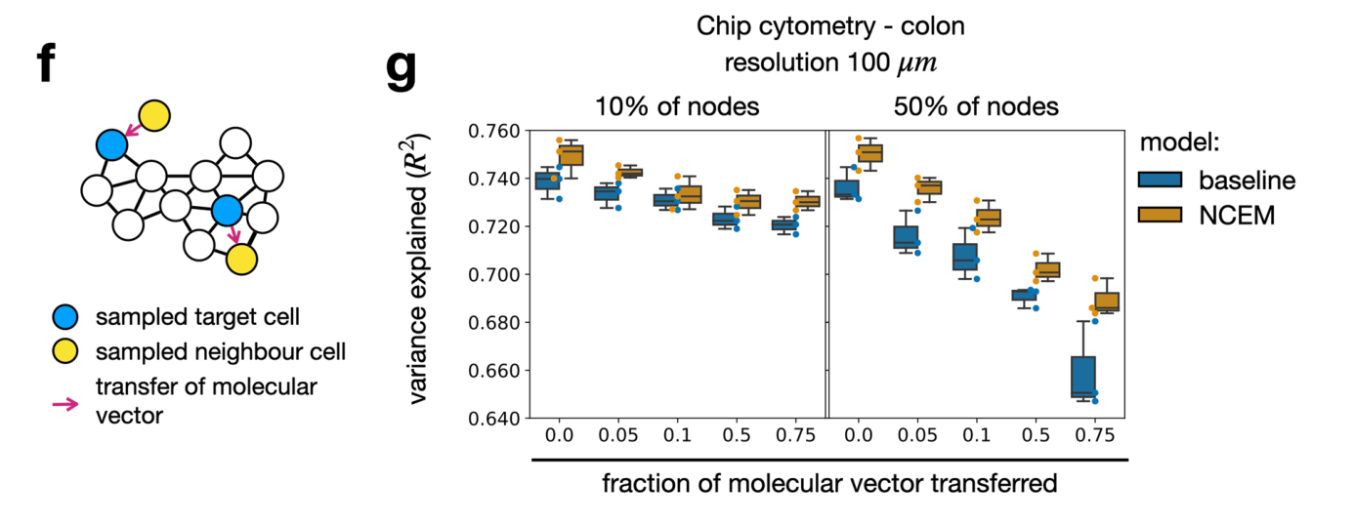
Sheds contradicting light on claims of robustness
MERFISH fetal liver (Lu et al. 2021)
Fischer, DS, Schaar, AC, and Theis, FJ (2022). Modeling intercellular communication in tissues using spatial graphs of cells. Nat Biotechnol, 1–5.
Notes:
Fischer in their paper already simulated cell segmentation errors by shuffling feature vectors between neighbouring cells. However, cell have a high tendency to be around cells of their own type, rendering this approach a bit futile.
Nevertheless, the variance explained still droppend fairly steeply when increasing the fraction of vectors transferred on the percent of nodes that were used
NCEM summary: Need for more robust upstream cell-type annotation and segmentation steps

Slide 15
MISTy
Tanevski et al. 2020
Notes:
MISTy is another CCC method which is highly flexible and annotation independent

Slide 16
Metamodel
Highly flexible and customizable
Intra–view
Inter–views
Learnable weight
parameters: “view effect”
Learnable function
Fixed aggregation function
Tanevski, J, Flores, ROR, Gabor, A, Schapiro, D, and Saez-Rodriguez, J (2020). Explainable multi-view framework for dissecting intercellular signaling from highly multiplexed spatial dat.
Notes:
Misty is very flexible and modular
Leave-one gene out based
MISTy is designed to distinguish the non-intrinsic effects from the intrinsic baseline
Intra-view: constructs a nonparametric and nonlinear model of the expression of each available marker as a function of the expression of all other markers at the same time (intrinsically) or the expression of other markers or features captured in the available views
Extra-views: customizable. G aggregator function can be chosen to summarize features of certain spatial context. Not limited to spatial context, can also summarise to e.g. TF and pathway activities
Y is the learned matrix of cells x features
Method is less affected by segmentation error due to custom aggregating functions around the index cell

Slide 17
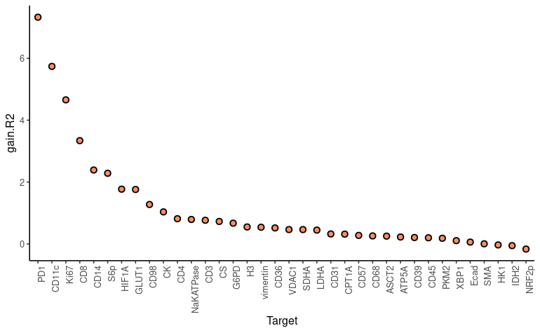
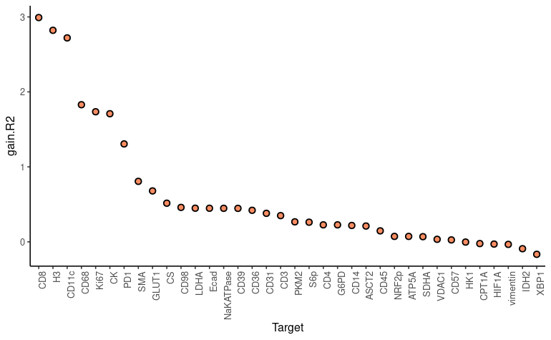
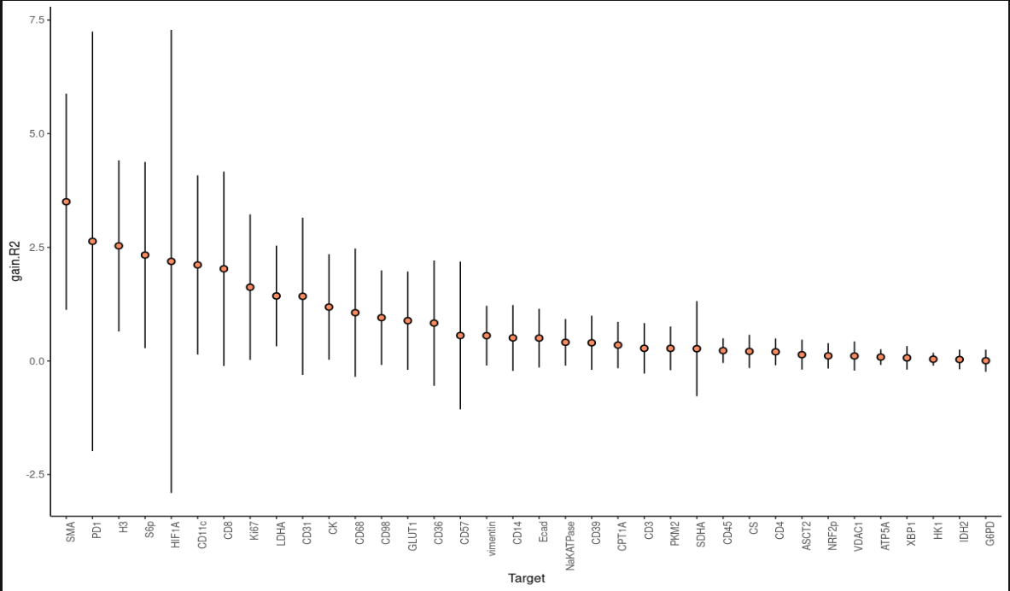
Output 1: Predictive performance improvement
Cancer
Healthy
Aggregated
Notes:
MISTy compares and analyses R2 variance explanation of the metamodel including the extra-views in comparison to the intra-view alone
In contrast to NCEM, where the conditions and batches are included in the model design, MISTy runs on individual images and the averages the results
In this case the average had a standard deviation often as big as the effect size
The individual images of different conditions show distinct CCC effects
We learn that the conditions and batches are to be strongly considered when applying MISTy since they can have a strong effect on the statistic aggregation.
It may not be wanted e.g. why aggregate cancer and healthy
It may be wanted: many samples
Calls for
Quality assessment
Intermediate step Interpretability

Slide 18
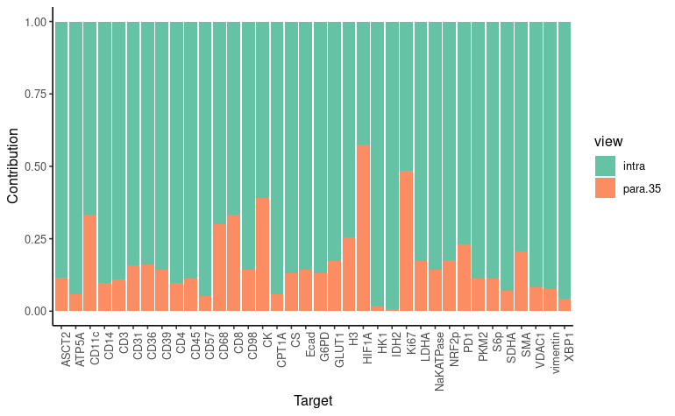
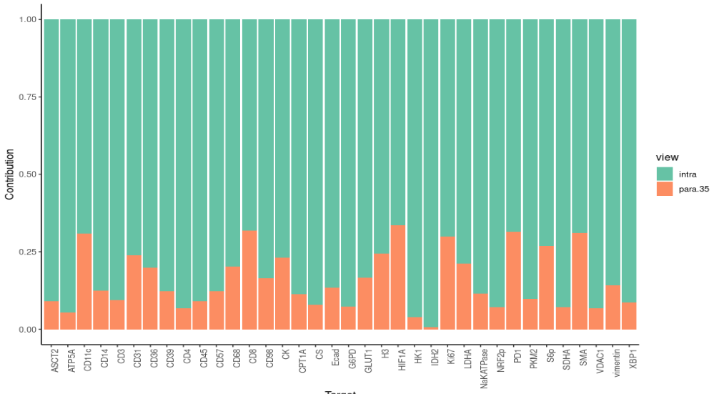
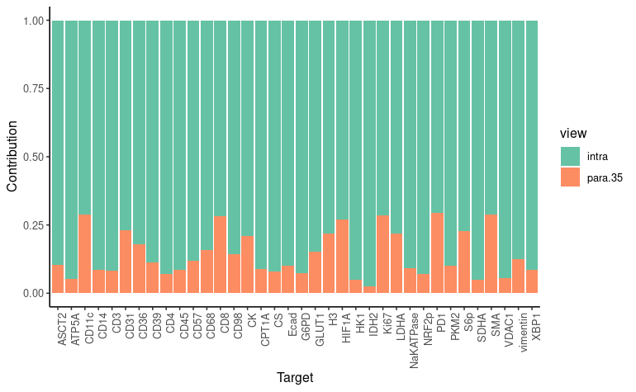
Output 2: Fusion parameters
Cancer
Healthy
Aggregated
Notes:
Second output: Each view is analyzed for its contribution to the total expression of each marker
Nice insight into the contribution of each view to the model

Slide 19
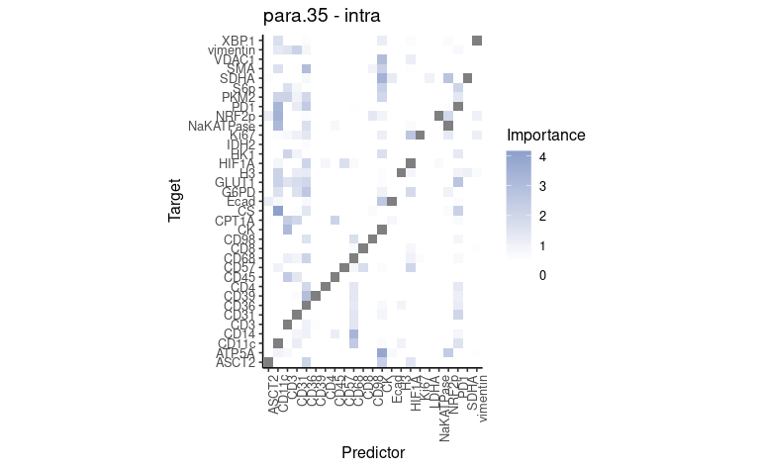
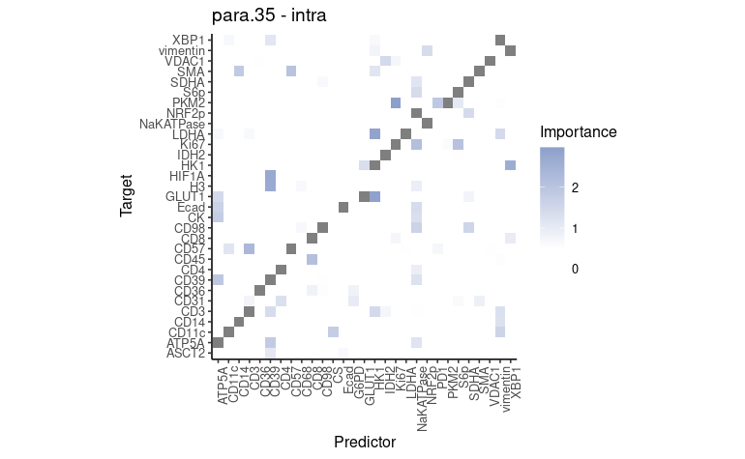
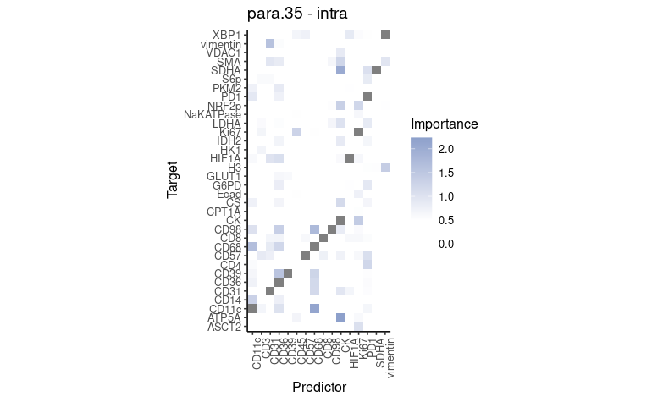
Output 3: Importances
Cancer
Healthy
Aggregated
Notes:
Third output
Importance of each marker by leave one out ensembl approach for each feature to predict the index feature

Slide 20
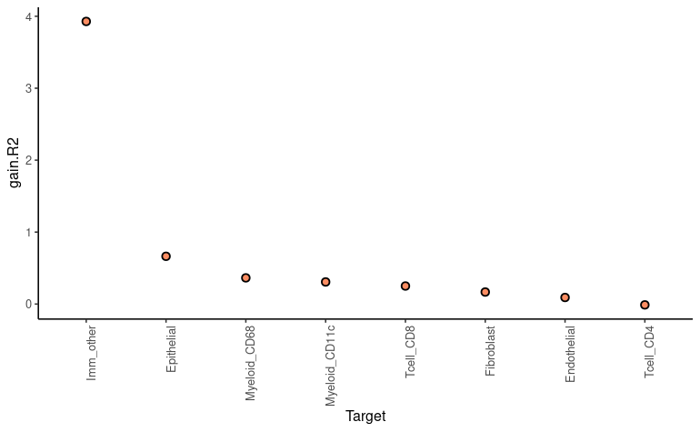
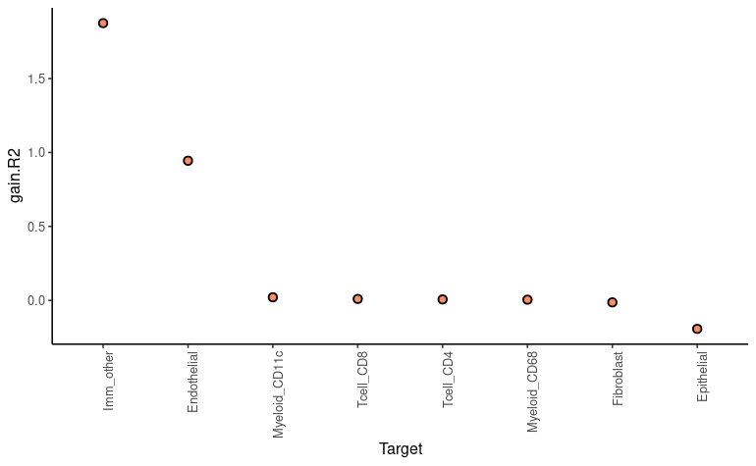
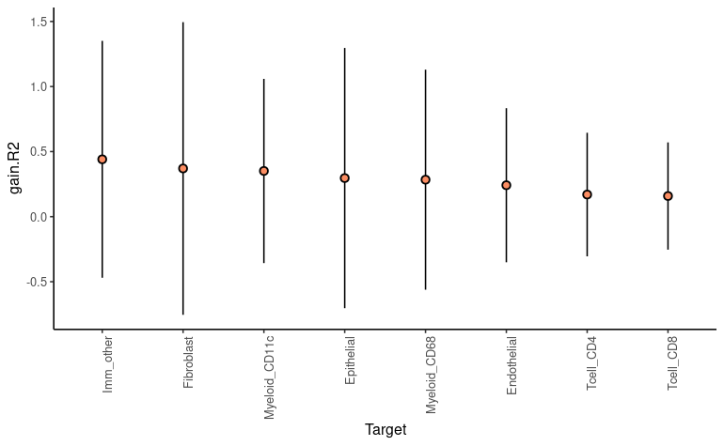
MISTy on cell-type
Cancer
Healthy
Aggregated
Notes:
Thanks to MISTy’s high flexibility, I changed the input and algorithm to make the model cell-type based, instead of feature-based
Yielded more consistent results than the feature based model (still huge std bars when aggregated)

Slide 21
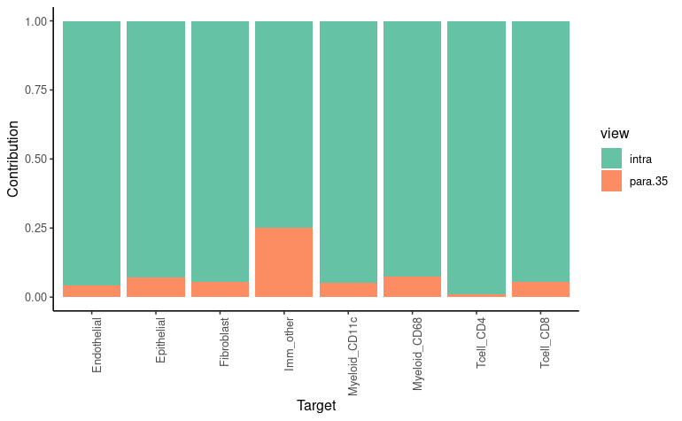
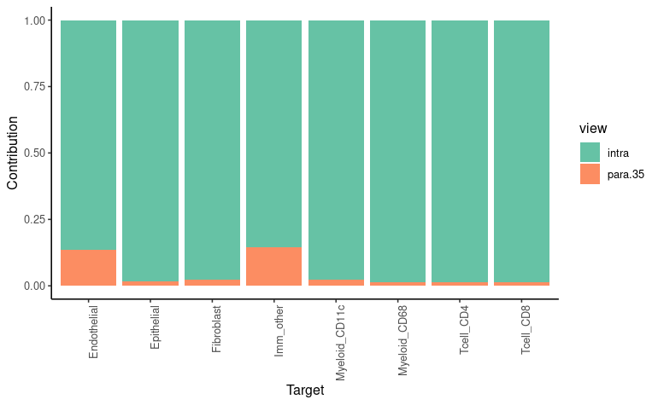
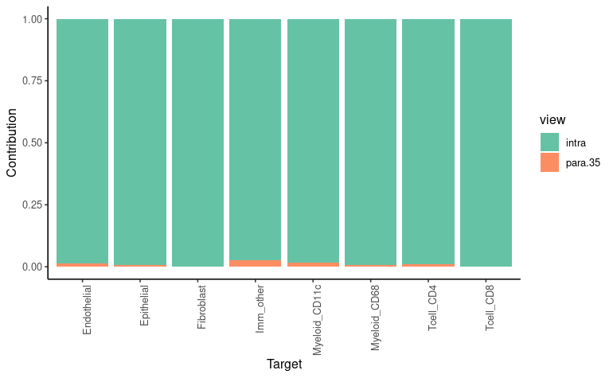
MISTy on cell-type
Cancer
Healthy
Aggregated

Slide 22
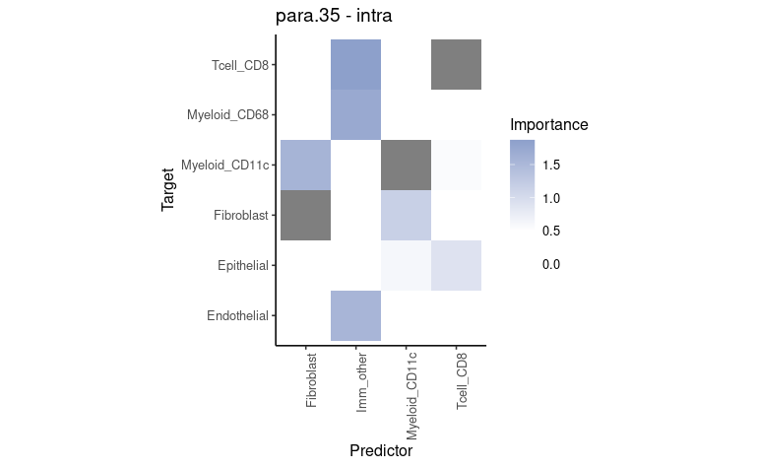
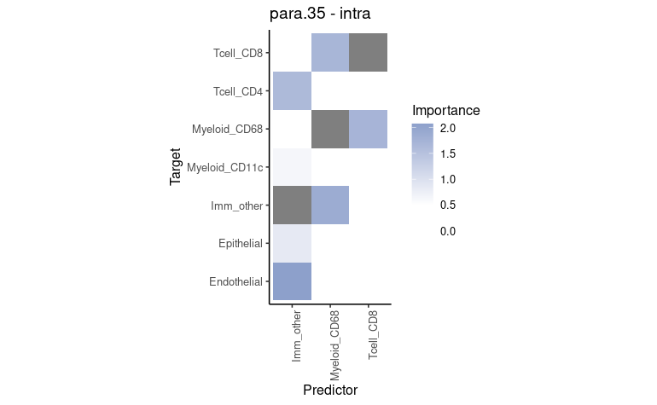
Output 3: Importances
Cancer
Healthy
Aggregated

Slide 23
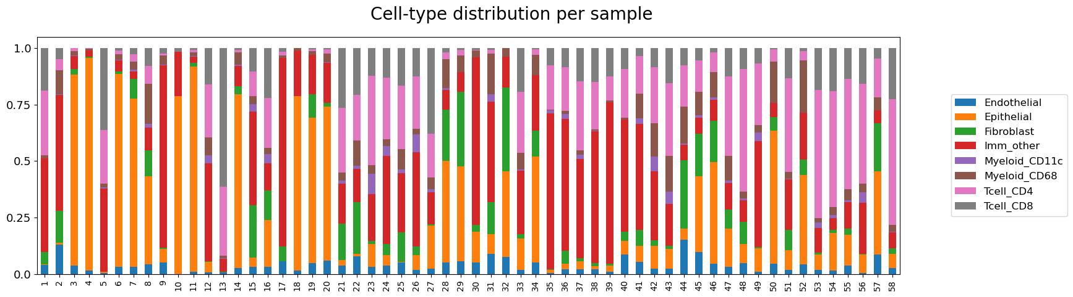
Uneven cell-type distribution may affect CCC methods
Notes:
Since MISTy is run on individual images, I wondered if maybe the huge error bars are due to cell-type distribution within a single sample.
This is a step I didn’t have time to finish. Basically our idea is to train on one condition (e.g. cancer) and evaluate on both conditions (healthy and cancer) to compare transfer robustness of MISTy
The cell-type distributions vary significantly even within the condition. This could lead to imbalance MISTy training and worse aggregations

Slide 24
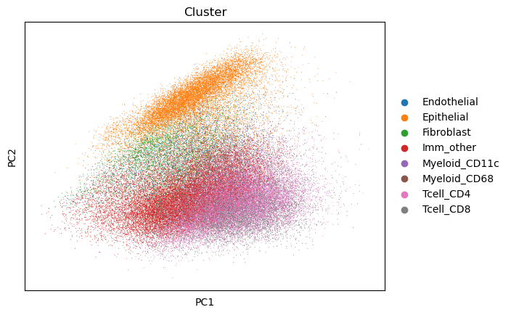
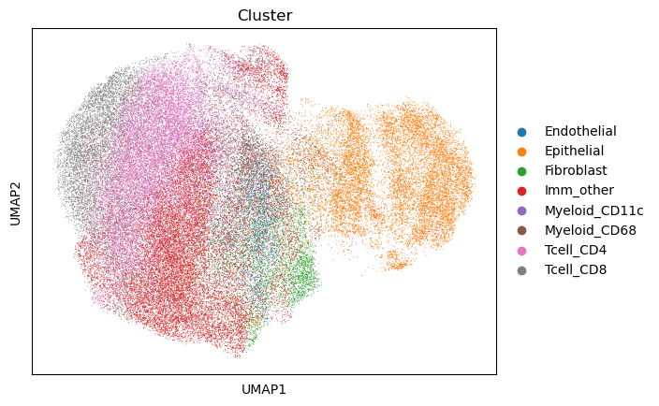
Cross donor and sample variability and clustering
Notes:
In addition, the first two principal components’ variance differentiate cell-type but it is still not enough to distinguish clear clustering. This could be another downside of integrating all data into the same space for NCEM or aggregated MISTy

Slide 25
Short summary
NCEM & MISTy
Model spatial interactions
Technology independent
Full feature space
NCEM | MISTY
Annotation dependent & segmentation sensitive | Flexible and modular (hypothesis driven)
All-together modelling | Hold-one gene out
Models batches and conditions | Aggregates batches and conditions
Linear* | Non-linear
*Flagship model
Notes:
NCEM is sensitive to cell-type annotation and segmentation
MISTY is highly flexible but output is cumbersome to interpret
MISTY relies on leave-one-gene hold-out models lead to false discoveries E.g. MISTy & SVAE
NCEM and MISTy output are complicated to benchmark

Slide 26
Outlook
Benchmark interaction matrices in different contexts:
Other spatial interaction methods e.g. COMMOT or DIALOGUE
Acquire quantitatively comparable outputs
Different technologies, tissues and conditions
Benchmarking to control for upstream effects
In-silico models

Slide 27
THM
Spatial cell-cell communication is still in its infancy
No existing consensus on approach, preprocessing
Upstream preprocessing and conditions severely affect CCC methods
NCEMs are graph-based expression models based on neighbouring cell-types
MISTy is a non-linear and highly flexible model designed for hypothesis based-approaches

Slide 28
Acknowledgements
Sabine Blum
Oliver Stegle
Elyas Heidari
Marc Jan Bonder
Ilia Kats
Olga Lazareva
Luca Marconato
Manu Saraswat
Brian Clarke
Kai Ueltzhöffer
Martin Rohbeck
Nathan Steebok (Saezlab)
Jovan Tanevski (Saezlab)
Julio Saez-Rodriguez

Slide 29
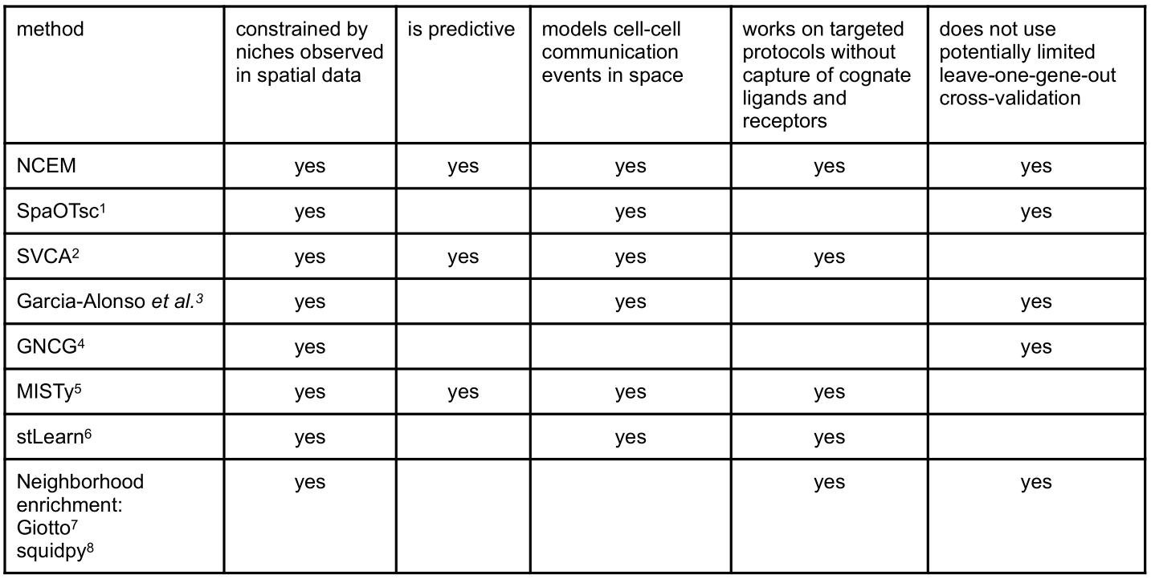
Spatial models comparison

Slide 30
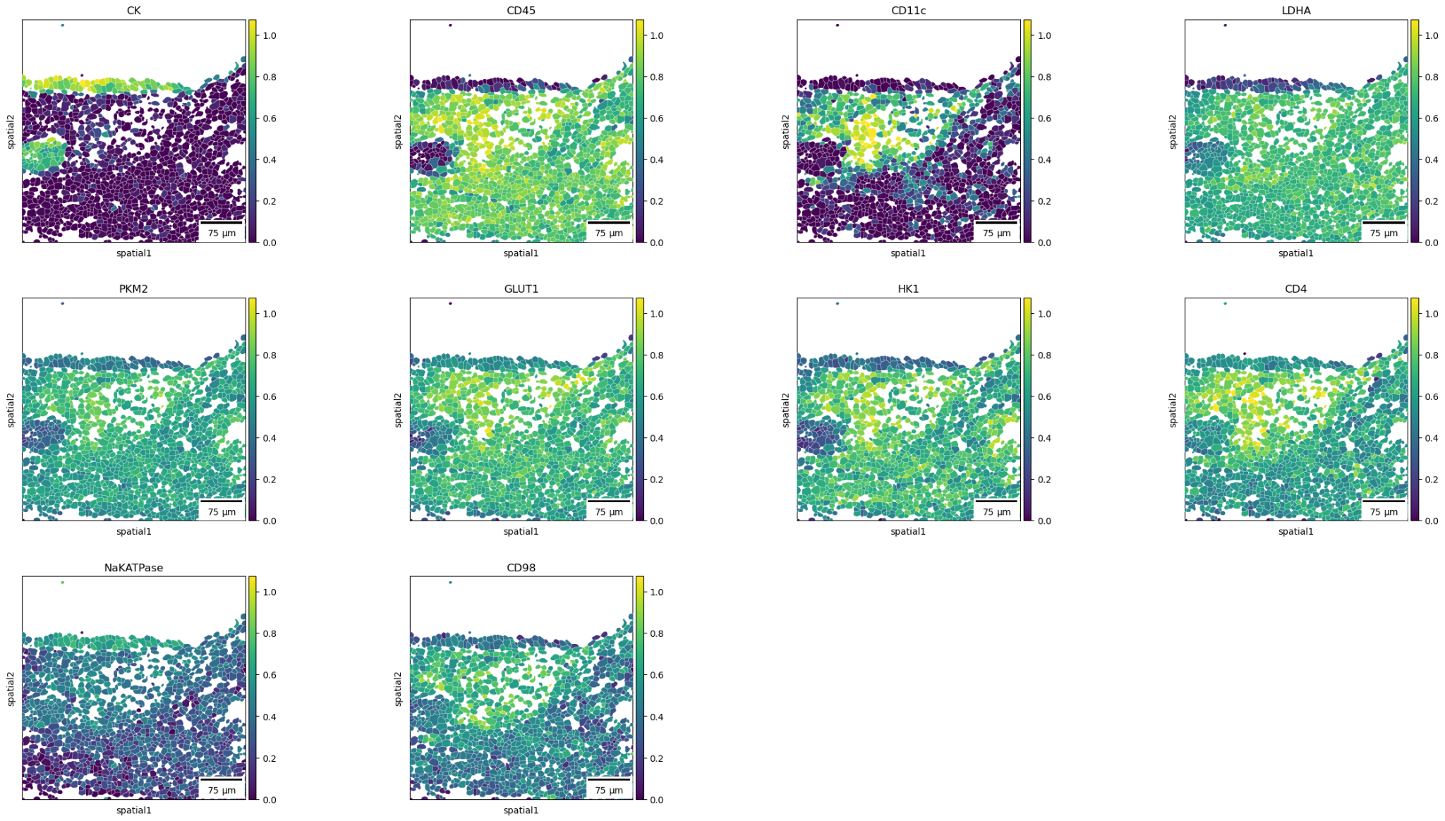
Moran’s score?

Slide 31
NCEM model training and testing workflow

Slide 32
NCEM model training and testing workflow
Define parameters
Initiate model
Train
Evaluation
Optionally by cell-type

Slide 33
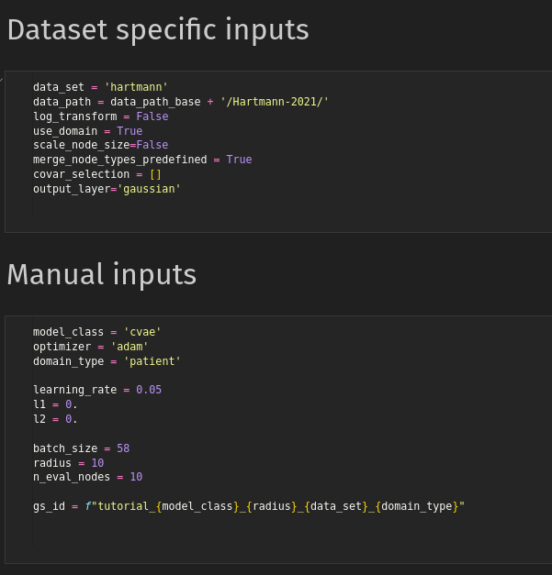
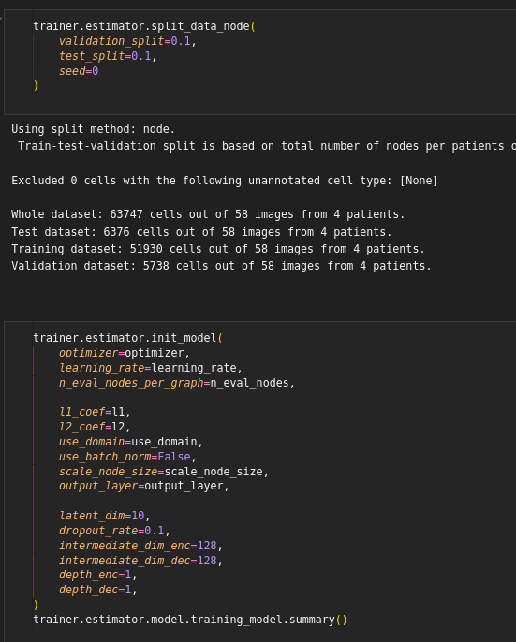
Defining parameters
Model initiation

Slide 34

Model training

Slide 35


Model evaluation

Slide 36
Dataset “Hartmann 2021” - Colorectal carcinoma
MIBI-TOF spot-wise proteomics, images and segmentation masks
36 metabolic regulome markers
1024 px^2
400 um^2
1100 +- 524 spots per image
4 patients
2 x colorectal cancer and adjacent tissue
2 x healthy tissue

Slide 37

Dataset “Hartmann 2021” - Colorectal carcinoma

Slide 38


Uneven cell-type distribution may affect CCC methods

Slide 39



Sample 23 - colorectal cancer

Slide 40
Linear model: output of interest
Interaction terms:
Matrix: sender cell-type x receiver cell-type x genes
genes
receivers
senders

Slide 41
Non-linear NCEM models

Slide 42

Non-linear NCEM models
Encode expression vectors
Graph neural network
Conditional variational autoencoder (CVAE)
Ligand–receptor autoencoder with L-R latent space

Slide 43


GNN
local graph embedding:

Slide 44

GNN
Did not outperform linear models in gene expression prediction

Slide 45

CVAE
Cell type and neighbours predictors as a condition in the variational posterior and the likelihood model

Slide 46


R-L kernel attention graph
Receptor-dimensional latent space (z)
Higher predictive performance than CVAE

Slide 47
Backup slides

Slide 48

Sender profile identity preservation
Sender similarity analysis

Slide 49

Type-coupling analysis
Couplings with germinal centers

Slide 50


Sender/Receiver effects on FDC-B cell axis

Slide 51

Sender profile identity preservation
Sender similarity analysis

Slide 52

Leave-one-gene out: MISTy

Slide 53
Leave-one-gene out: SVCA

Slide 54

Variance decomposition

Slide 55

Linear models outperform baseline non-spatial models in spot-based technologies

Slide 56

Sender-receiver effects workflow
Create AnnData object
Input directory and file structure blueprint based on DataLoader class
Call custom function

Slide 57
Data loaders
Hartmann2021 MIBI-TOF - colorectal carcinoma & healthy colon.
Zhang2020 MERFISH - Brain
PascualReguant2021 MELC - Tonsils
Schürch2020 - Colorectal Cancer
Jarosch
Lohoff
10xVisiumMouseBrain
10xLymphnode

Slide 58

Data loader Hartmann

Slide 59

Type-coupling analysis

Slide 60


Squidpy: neighbourhood enrichment

Slide 61
Spatial models comparison

